Slide 1
DATA SCIENCE CONSULTING
Softsensor.AI

Slide 2
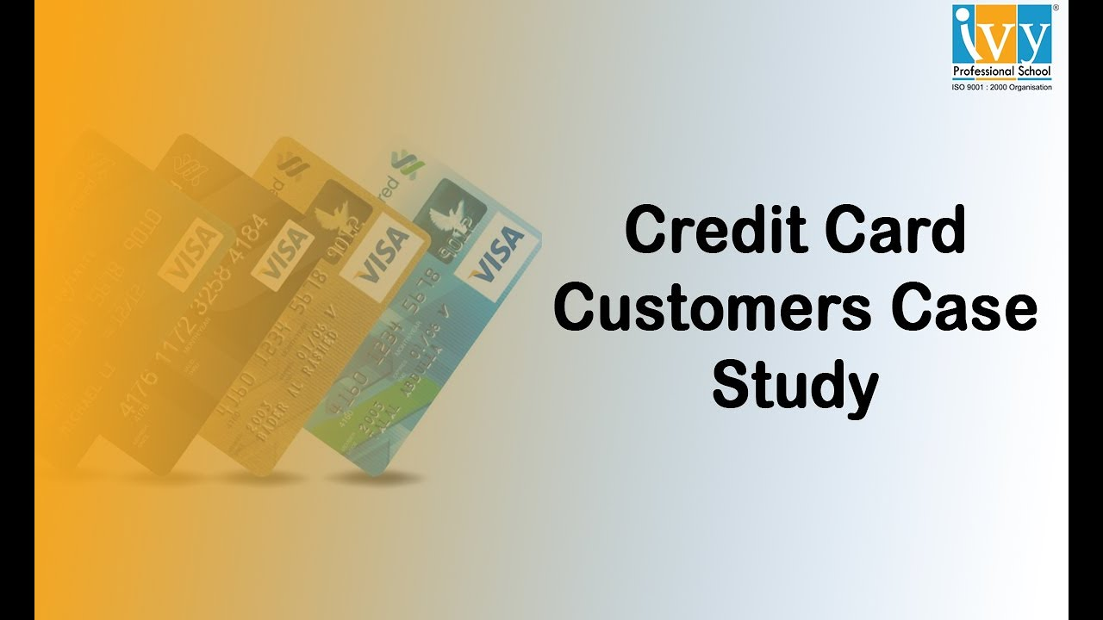
INTRODUCTION
This case requires to develop a customer segmentation to define marketing strategy. The sample Dataset summarizes the usage behavior of about 9000 active credit card holders during the last 6 months. The file is at a customer level with 18 behavioral variables.

Slide 3
DATA DICTIONARY
CUSTID : Identification of Credit Card holder (Categorical)
BALANCE: Balance amount left in their account to make purchases
BALANCEF_REQUENCY : How frequently the Balance is update
PURCHASES : Amount of purchases made from account
ONEOFF_PURCHASES: Maximum purchase amount done in one-go
INSTALLMENTS_PURCHASES : Amount of purchase done in installment
CASH_ADVANCE: Cash in advance given by the user
PURCHASES_FREQUENCY : How frequently the Purchases are being mad
ONEOFF_PURCHASES_FREQUENCY: How frequently Purchases are happening in one-go
CASH_ADVANCE_FREQUENCY : How frequently the cash in advance being paid
CASH_ADVANCE_TRX : Number of Transactions made with "Cash in Advanced"
PURCHASES_TRX: Number of purchase transactions made
CREDIT_LIMIT: Limit of Credit Card for user
PAYMENTS : Amount of Payment done by user
MINIMUM_PAYMENTS : Minimum amount of payments made by user
PRC_FULL_PAYMENT : Percent of full payment paid by user
TENURE : Tenure of credit card service for user

Slide 4
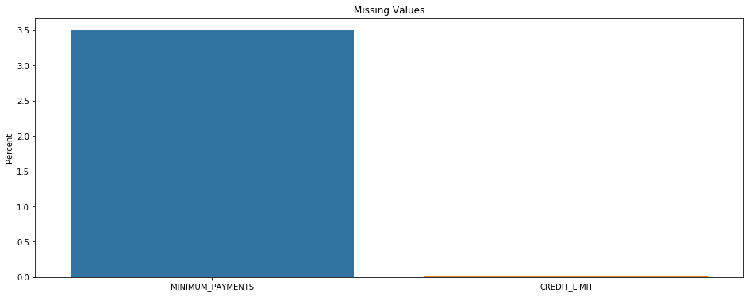
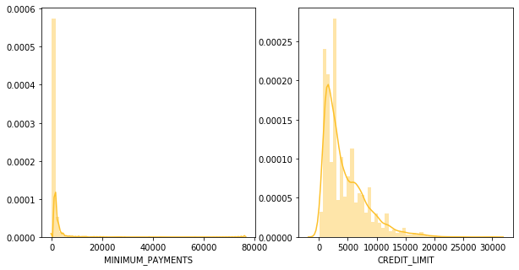
TREATING MISSING VALUES
After discovered the data with missing value and knowing its distribution, the best way to fill missing values is median
Variable Distribution

Slide 5
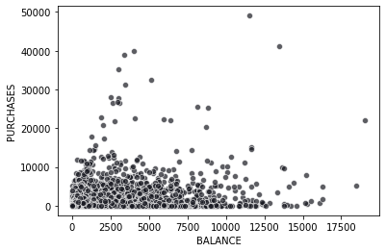
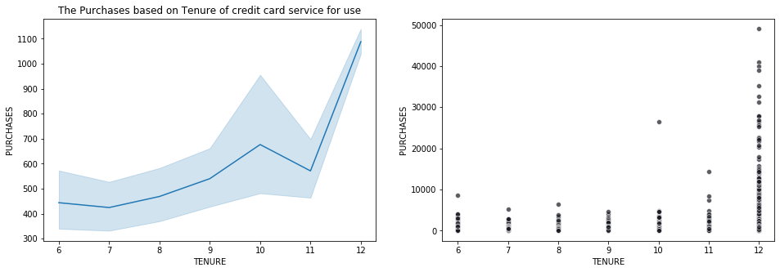
EXPLORATORY DATA ANALYSIS
Now we can confirm that with the increase in the period of use of the card, the purchase price increases, especially for a year, because there is a big difference between it and the rest

Slide 6
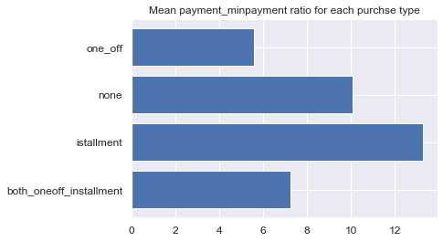
As per above detail we found out that there are 4 types of purchase behavior in the data set. So we need to derive a categorical variable based on their behavior
EXPLORATORY DATA ANALYSIS
Customers with installment
Purchases are paying dues

Slide 7
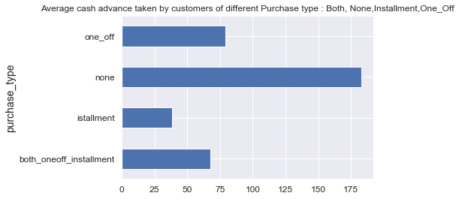
EXPLORATORY DATA ANALYSIS
Customers who don't do either one-off or installment purchases take more cash on advance

Slide 8
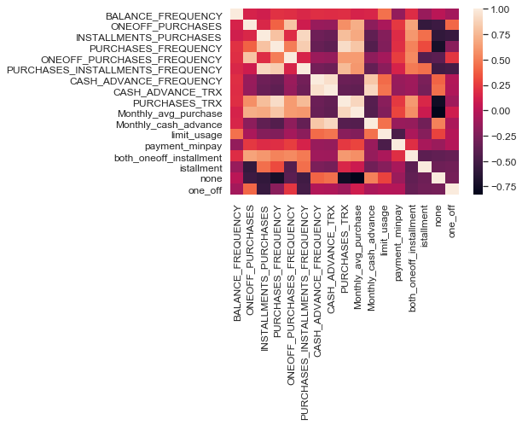
Heat map shows that many features are co-related so applying dimensionality reduction will help negating multi colinearity in data

Slide 9
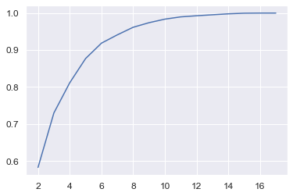
Since 5 components are explaining about 87% variance so we select 5 components
So initially we had 17 variables now its 5 so our variable go reduced

Slide 10
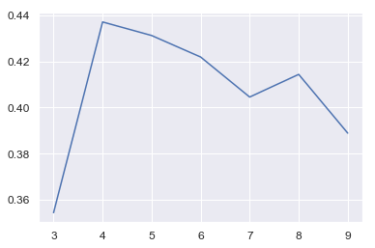
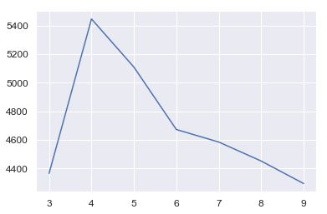
CHECKING PERFORMANCE METRICS FOR KMEANS
I am validating performance with 2 metrics Calinski harabasz and Silhouette score
Performance metrics suggest that K-means with 4 cluster is able to show distinguished characteristics of each cluster.

Slide 11
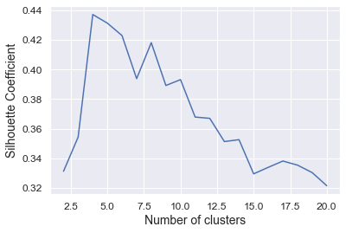
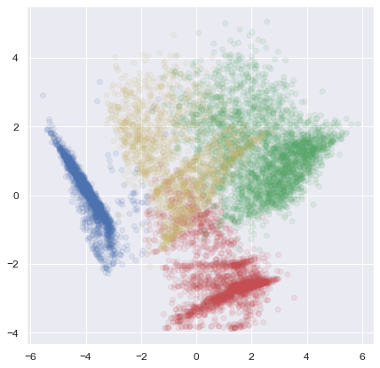
CLUSTERING
It is very difficult to draw individual plot for cluster, so we will use pair plot which will provide us all graph in one shot.

Slide 12
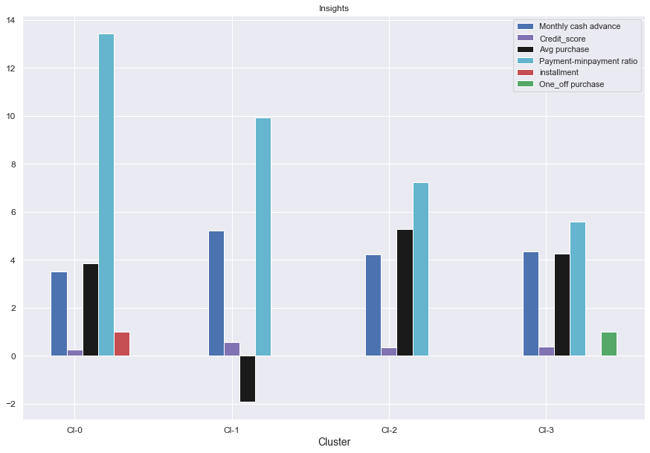
CLUSTERING
Insights
Clusters are clearly distinguishing behavior within customers
Cluster 0 is the group of customers who have high Monthly_avg purchases and installment, have comparatively good credit score.
This group is about 31% of the total customer base
Cluster 1 is taking maximum advance_cash and is paying comparatively less minimum payment & doing no purchase transaction. This group is about 23% of the total customer base
Cluster 2 customers have good credit score and are paying dues. This group is about 25% of the total customer base
Cluster 3 customers are doing maximum One_Off transactions and least payment ratio.
This group is about 21% of the total customer base

Slide 13
MARKETING STRATEGY SUGGESTED
a. Group 0
They are potential target customers who are paying dues and doing purchases and maintaining comparatively good credit score ) -- we can increase credit limit or can lower down interest rate -- Can give premium card /loyalty cards to increase transactions
b. Group 1
This group is taking maximum advance cash and doing no purchases. We can target them by providing less interest rate on purchase transaction
d. Group 2
This group is performing best among all as customers are maintaining good credit score and paying dues on time. -- Giving rewards point will make them perform more purchases.
c. Group 3
This group is has minimum paying ratio and using card for just oneoff transactions (may be for utility bills only). This group seems to be risky group.

Slide 14
spsonal68@gmail.com 91- 8802259509 THANKYOU

